Slide 1
Design and Analysis of Algorithms Lab
Dr. Sujata Joshi

Slide 2
PART B
12
DigiMap services is a module in G-Maps which is used to find the distance from one place to another or from your location to the nearest desired location. This requires the Shortest Path Algorithm, as there are various routes/paths connecting them but it has to show the minimum distance. . Represent a city/place with a vertex and the route between two cities/places as an edge, then by using Dijkstra’s algorithm, find the shortest routes between any two cities/places or from one city/place to another city/place.

Slide 3
Dijkstra's algorithm, is a graph search algorithm that solves the single-source shortest path problem for a graph with non negative edge path costs, outputting a shortest path tree. This algorithm is often used in routing.
For a given source vertex (node) in the graph, the algorithm finds the path with lowest cost (i.e. the shortest path) between that vertex and every other vertex. It can also be used for finding costs of shortest paths from a single vertex to a single destination vertex by stopping the algorithm once the shortest path to the destination vertex has been determined. For example, if the vertices of the graph represent cities and edge path costs represent driving distances between pairs of cities connected by a direct road, Dijkstra's algorithm can be used to find the shortest route between one city and all other cities. As a result, the shortest path first is widely used in network routing protocols.

Slide 4
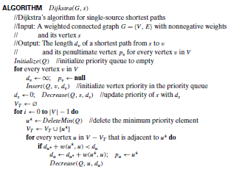

Slide 5
Dijkstra’s algorithm.
Dijkstra’s algorithm finds the shortest paths to a graph’s vertices in order of their distance from a given source.
First, it finds the shortest path from the source to a vertex nearest to it, then to a second nearest, and so on.
In general, before its ith iteration commences, the algorithm has already identified the shortest paths to i − 1 other vertices nearest to the source.
These vertices, the source, and the edges of the shortest paths leading to them from the source form a subtree Ti of the given graph.

Slide 6

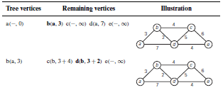
Example

Slide 7
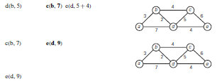
The shortest paths and their lengths are as follows:
from a to b : a − b of length 3
from a to d : a − b − d of length 5
from a to c : a − b − c of length 7
from a to e : a − b − d − e of length 9

